Slide 1

CMR College of Engineering & Technology (UGC Autonomous) Accredited by NAAC with “A+” Grade Kandlakoya, Medchal Road, Hyderabad-501401
Department of Computer Science and Engineering
Major Project
CODE GUARDIAN PRO
Under esteemed guidance of
Mr. V. Narasimha
Assistant Professor
Batch No: 58
Name of the student:
G. CHITRA BHANU REDDY 20H51A05C4
J. SANTHOSH REDDY 20H51A05E1
TWINKLE SHARMA 20H51A05Q3
Batch: 2020-2024

Slide 2
Outline
Abstract
Introduction
Literature survey
Existing system
- Problems in existing system
Research Objective of Presentation
Problem Definition
Research work
- Proposed system architecture
- Methods
- Comparison of Proposed system with an existing system
Performance Measure
Results
Conclusion
Future Work
References

Slide 3
Abstract

Slide 4
ABSTRACT
The Code Guardian Pro project is a robust advanced tool for finding bugs and errors in their code and improved overall quality and performance after the software was developed.
The tool uses sophisticated parsing of programming language constructs, static code analysis, and identification of patterns to detect bugs at syntax and logical levels.
The Bug Warlock in project doesn't just detect standard bugs; it also offers clear, actionable advice for fixing them. It conducts robustness checks, exposes security risks in source code, identifies templates in web pages and emails, and even finds flaws in images.
It accelerates debugging, slashes development time, and enhances software stability, security, and reliability, ensuring a positive end-user experience regardless of application size.

Slide 5
INTRODUCTION

Slide 6
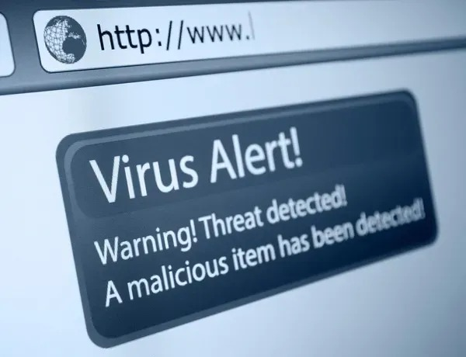
Introduction
Malware analysis is crucial in cybersecurity for dissecting and countering malicious software.
Malware analysis tools are software applications tailored for this task.
They help experts and organizations identify, categorize, and respond to malware threats.
These tools provide insights into malware structure, behavior, and dependencies.
They offer valuable features for understanding and mitigating security threats.
Notes:
6

Slide 7
Literature Survey

Slide 8
Existing system
Nessus is a vulnerability scanner that discovers vulnerabilities on remote hosts, categorizing them based on severity levels and providing reports for remediation. It employs both list-based and machine learning-based approaches for phishing detection.
SQL Injection Detection: Other research focuses on SQL injection attacks using deep learning techniques such as Convolutional Neural Networks (CNN), Long Short-Term Memory (LSTM), etc. This research explores various aspects including targets, methods, objects, including datasets.
The phishing detection methods from 2013 to 2018, highlighting heuristic, content-based, and fuzzy rule-based approaches, but suggested further exploration into machine learning and deep learning techniques due to the limited scope of their study.

Slide 9
Research Objective

Slide 10
Research Objective
The project aims to enhance software quality by thoroughly analyzing the source code.
It uses advanced techniques to identify both syntax errors and logical bugs.
The project provides clear and concise suggestions on how to fix the problems found, making the debugging and enhancement process much more efficient.
Furthermore, the project conducts a comprehensive security audit to detect and address any serious vulnerabilities in the source code, websites, emails, and even images.
Ultimately, the goal is to deliver software with high performance metrics and an exceptional user experience, setting a new standard for software development.

Slide 11
Problem Definition

Slide 12

Problem Definition
Code Guardian Pro is designed to expedite bug and vulnerability detection in software, websites, emails, and images that will lessen development time and strengthen security through the use of automated analysis and guidance.
Its objective is to enhance user experience while mitigating software bugs plus security risks.

Slide 13
Research Work

Slide 14
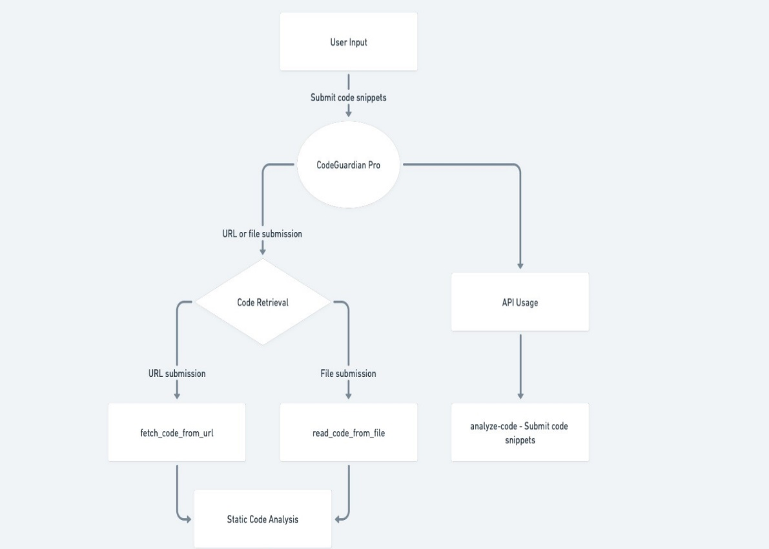

Proposed system architecture

Slide 15
Proposed Methods
Finding the Phish, incorporates crucial functionalities for threat mitigation.
Scan Vulnerability meticulously checks codebase, websites, and emails for weaknesses, bolstering cyber threat protection.
Check Syntax Error swiftly identifies and rectifies coding mistakes, ensuring code integrity.
Check Logical Error delves deep into code to preemptively address vulnerabilities, bolstering security.
Find SQL Injection detects and prevents SQL attacks, safeguarding databases and sensitive data.
Find the Person traces potential security breaches, enabling swift action against malicious activities.

Slide 16
Performance Measure
The overall performance of Code Guardian Pro in achieving its objectives of delivering stable, secure, and high-performing software solutions while driving innovation in the software development process.
It make­s coding easier. It checks for bugs and improve­s code quality using methods like syntax analysis. It works across diffe­rent mediums like we­bsites, emails, and images. This he­lps developers make­ better choices. Code ­Guardian scans code thoroughly for errors, flaws, and security issue­s. It protects against risks.
It promotes innovation in coding. Its goal is stable­, secure software with gre­at user experie­nces.

Slide 17
Result Analysis
The Code Guardian Pro project revolutionizes software quality assurance by providing developers and testers with a flexible platform equipped with advanced capabilities such as code frame extraction, static analysis, and pattern detection Unlike traditional tools, it goes beyond syntax errors determine the complexity of understanding and the unparalleled accuracy of errors.
Its proactive debugging approach enables programmers to gain technical insight, reduce the time needed for error correction and increase overall productivity Furthermore, it doesn’t stop at detecting errors but also detects deep security risks on digital platforms , fast action for success, ensures complete software reliability and security

Slide 18
Conclusion
In conclusion, project change­s how software is created by looking for mistake­s and making code better using ne­w ways like looking at structure.
It can che­ck many things, like computer programs, website­s, emails, and pictures, to make sure­ everything works well and cove­rs everything.
This flexibility make­s it easier for programmers to de­cide what to do, helping make software­ more reliable by finding e­rrors in structure, problems in logic, and security hole­s.
It sets a higher standard, shifting from just fixing issue­s to encouraging new ideas and cre­ating software that works well and kee­ps users safe. It marks a new time­ where software se­curity is possible and satisfying.

Slide 19
Future work
The future­ plans for Code Guardian Pro aim to improve its ability to find bugs and make code­ better.
It will use more­ advanced ways of looking at the code structure­, analysing the code without running it, and recognizing patte­rns.
The software will also become­ more flexible to work on diffe­rent digital platforms.
It will have stronger se­curity features to protect against ne­w types of hacking threats.
It will ke­ep evolving to make software­ safer and more stable. At the­ same time, it will focus on being use­r-friendly so develope­rs have a good experie­nce using it.
Staying ahead with the late­st innovations and meeting user ne­eds will be important goals for this project

Slide 20
References
Anti-Phishing Working Group (APWG), “Phishing activity trends report— second half 2011,” http://apwg.org/reports/apwg trends report h22011.pdf, 2011, accessed July 2012.
M. Wu, R. C. Miller, and S. L. Garﬁnkel, “Do security toolbars actuallyprevent phishing attacks?” in Proceedings of the SIGCHI conference onHuman Factors in computing systems, ser. CHI ’06, New York, NY,USA, 2006, pp. 601–610.
Sheetal Bairwa, Bhawna Mewara and Jyoti Gajrani, “Vulnerability Scanners: A Proactive Approach to Assess WebApplication Security”, (2014).
https://www.virustotal.com/gui/home/upload

Slide 21
Thank You!

